Slide 1
Building Your STEM Trajectory
Mary Khetani, Jill Wenderott, Valerie Fako Miller,
On behalf of Association for Women in Science Chicago Chapter

Slide 2
Sometimes courage is the quiet voice at the end of the day saying, “I will try again tomorrow” -- Radmacher

Slide 3
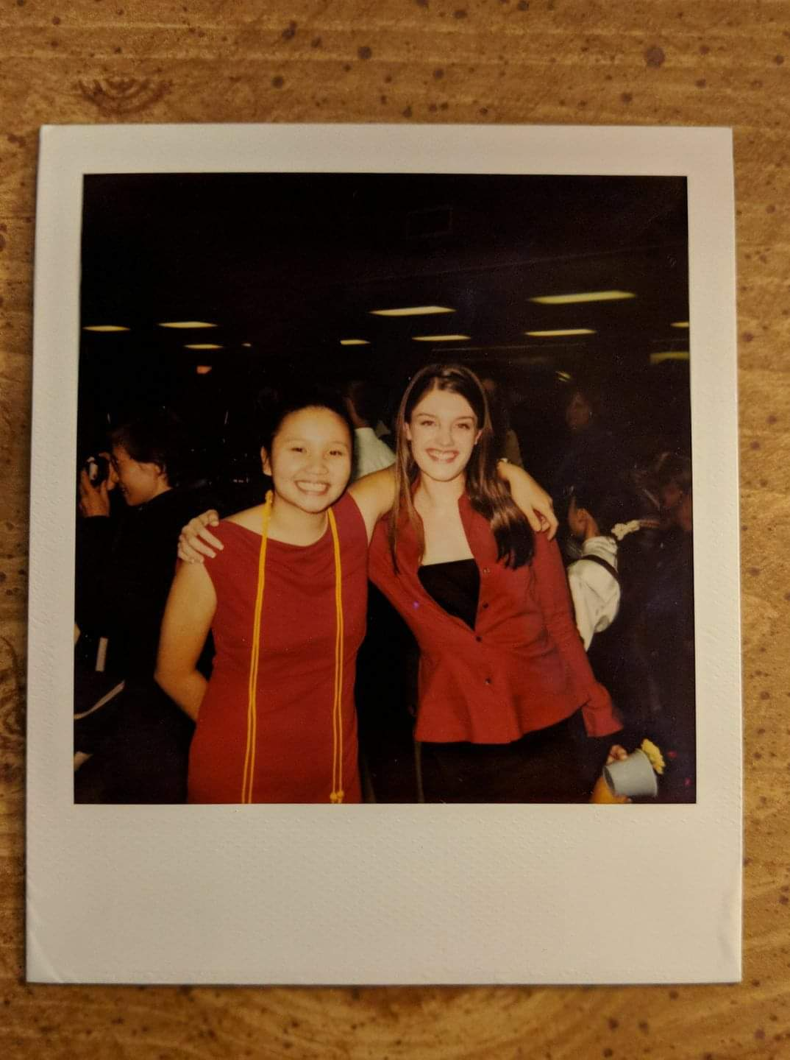
“I graduated high school when the show CSI was all the rage, so my plan was to major in chemistry and become a forensic scientist. I did end up majoring in chemistry, but decided to pursue graduate school instead. A career is a long journey and rarely follows a linear path, so my advice is to not be afraid to take chances and look at opportunities outside your comfort zone.”
– Valerie Fako Miller

Slide 4
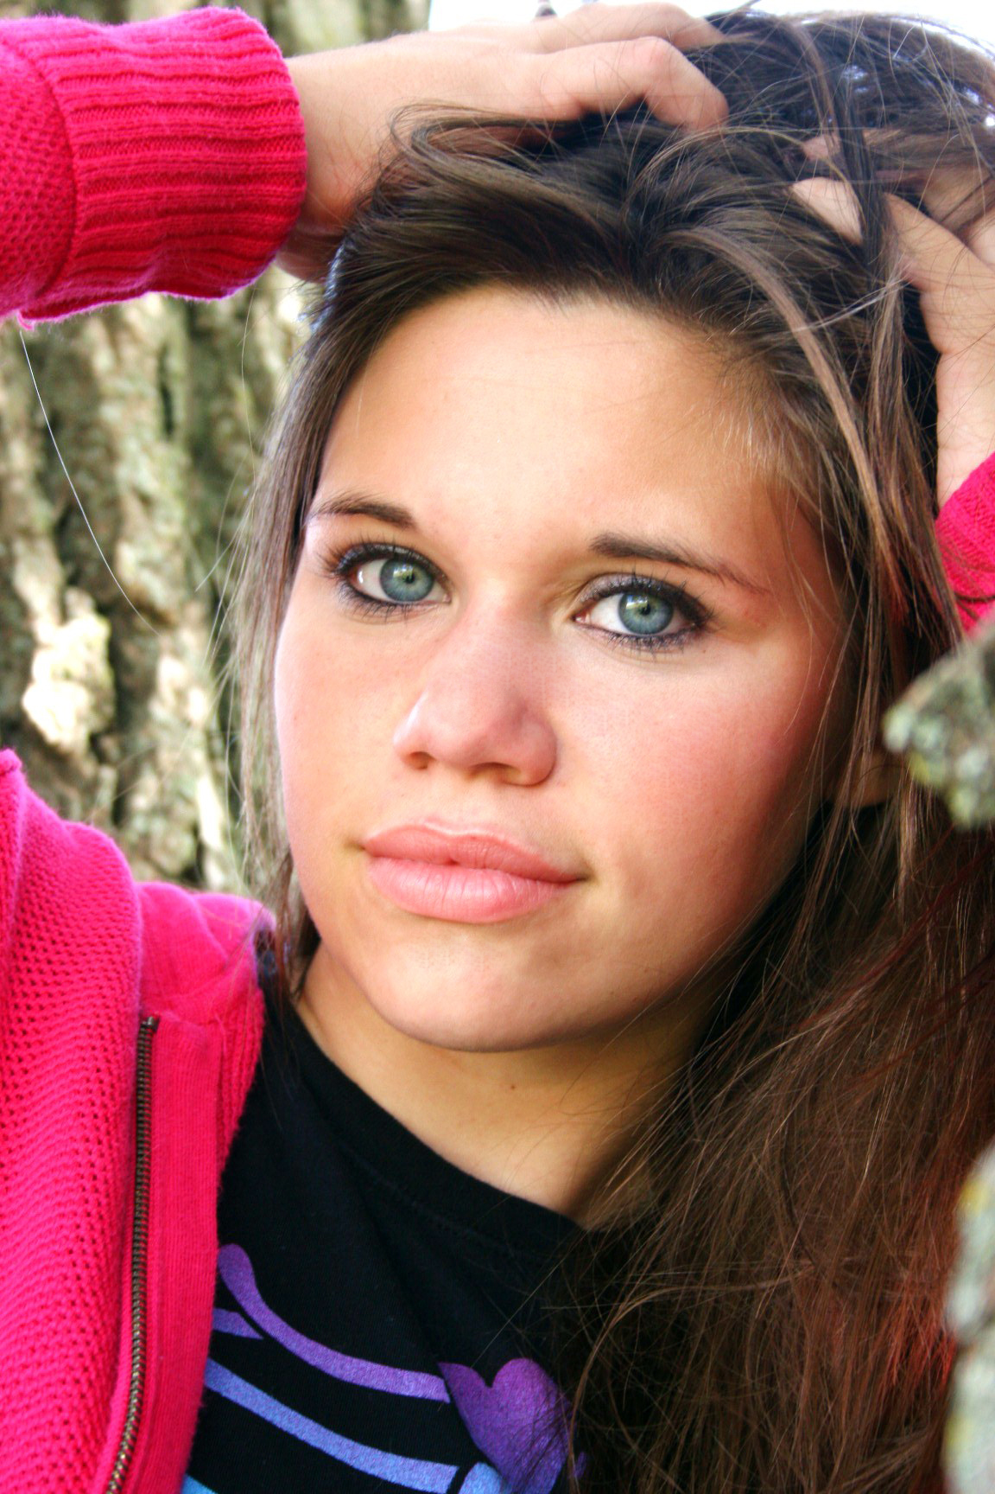
My plans upon my high school graduation were to major in geology, without realizing how much I would eventually find Geology 101 to not be my best fit. My advice: be open to new opportunities and ideas. You may be surprised to find new passions, which change your whole career and life trajectory. Without a random survey class and a summer research experience, I would have never majored in physics nor attended graduate school.”
- Jill Wenderott, PhD

Slide 5
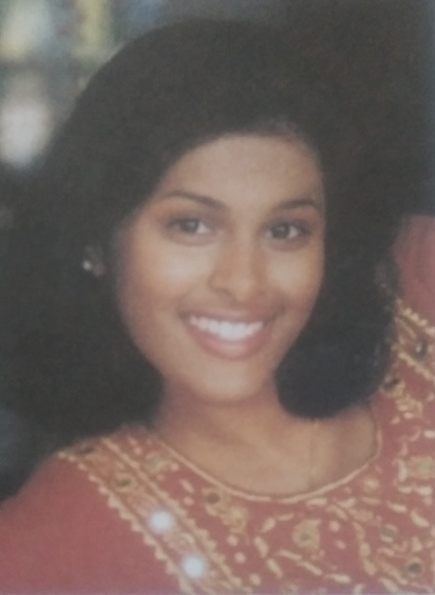
“I grew up in a low-income immigrant household and counted down the years until HS graduation. I watched ER without fail during my senior year of HS, and had big plans to become a pediatrician and work for UNICEF … I even had a UNICEF poster on my dorm room wall. My college advisors challenged me to earn course credits for learning through service and research. I took this challenge and got placed at an urban early intervention center serving children with disabilities and their families. For more than a year, I was mentored to discover the magic of pediatric rehabilitation teams. I also got placed in a stroke research lab, though I was a major lab hazard, and spent more than a year being mentored to discover how science bolsters clinical practice. Today, I conduct research to improve rehabilitation for children and families. My advice: Life is a puzzle. Every piece fits. Aim high and dig deep in all sorts of directions and with mentorship, so that you have lots of quality pieces for your masterpiece.”
Mary Khetani, ScD, OTR/L

Slide 6
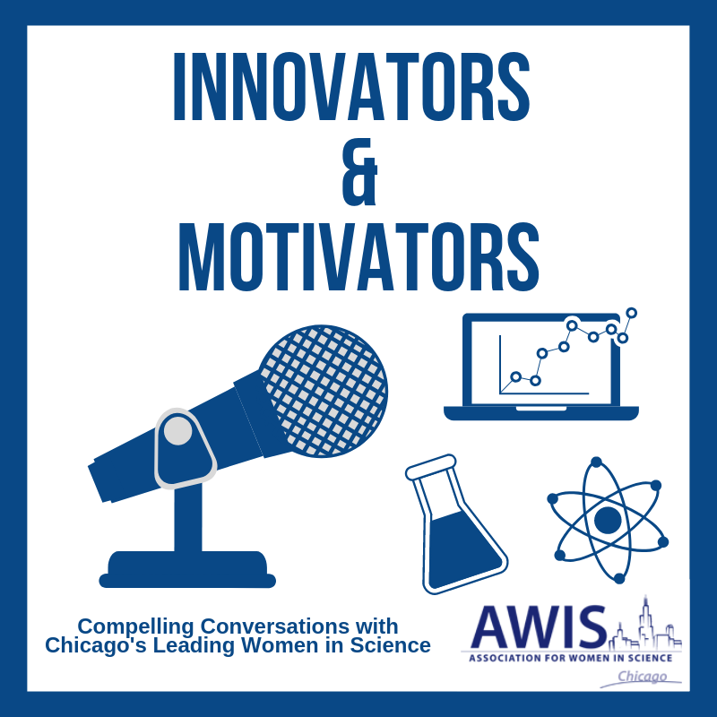
Logo credit: Vivian Villegas, MS, OTR/L, clinical doctoral student in occupational therapy at University of Illinois at Chicago

Slide 7
Doris Espiritu and Monet Worsham
Listen to Monet engage her mentor Doris in how they ‘keep swimming’ as successful women in science. She talks about a grant she was awarded from the National Science Foundation to build workforce capacity for those students seeking STEM careers while situated in community colleges.
https://soundcloud.com/user-423131560/awis_podcast

Slide 8
Sangeetha Madhavan and Mary Ellen Stoykov, together with Erin King
Listen to Erin engage her mentors Sangeetha and Mary Ellen about how to ‘just do it and the rest will follow’ in terms of building and sustaining competitive and collaborative research careers, and without compromising on your personal ambitions.
https://soundcloud.com/user-423131560/output

Slide 9
Sylvia Perry and James Wages
http://www.awis-chicago.org/scientist-of-the-month

Slide 10
Stay safe, healthy, and connected! www.awis-chicago.org
Mary Khetani: mkhetani@uic.edu
Jill Wenderott: jkw@northwestern.edu
Valerie Fako Miller: valerie.fako@gmail.com

